Slide 1
ACROSS 2nd Meeting
9 Mar 2026

Slide 2
Agenda
Introduction
IRB progress updates/survey translation
Author policy reminder
Data policy/reuse
Survey platform
Timeline update

Slide 3
IRB progress and survey translation
14 centers
 | Questionnaire translation |  | IRB status
Done | 8 | Obtained | 3
In progress | 4 | Submitted | 2
Not yet started | 1 | Started not yet submitted | 4
Not needed | 1 | Not yet started | 5

Slide 4
Timeline
 | Original timeline | Revised timeline
Final survey shared | 6 Oct 2025 | Done
Translation/IRB application | Oct-Dec 2025 | Mar 2026 (submitted)
Data collection | Jan –June 2026 | Upon IRB approval - Oct 2026
We hope to present the progress during the ASSM interim meeting in Sep 2026;
Aim to finish the data collection by 2026

Slide 5
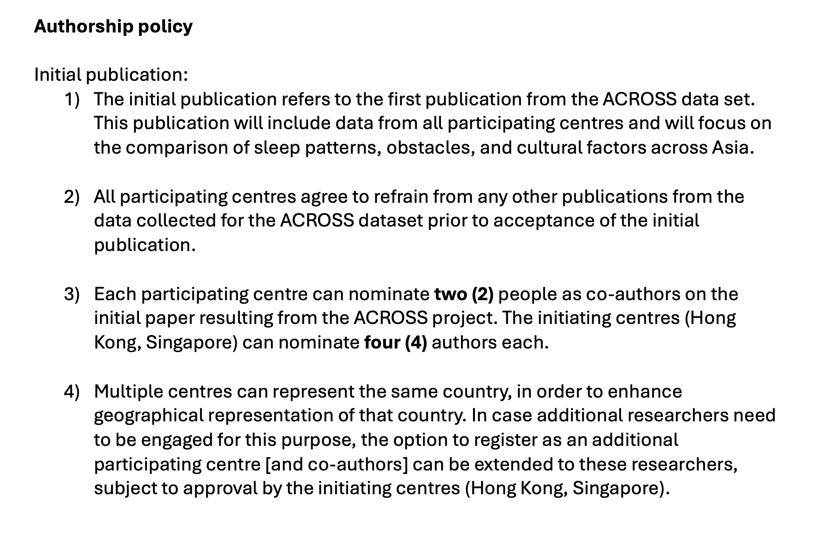

Slide 6
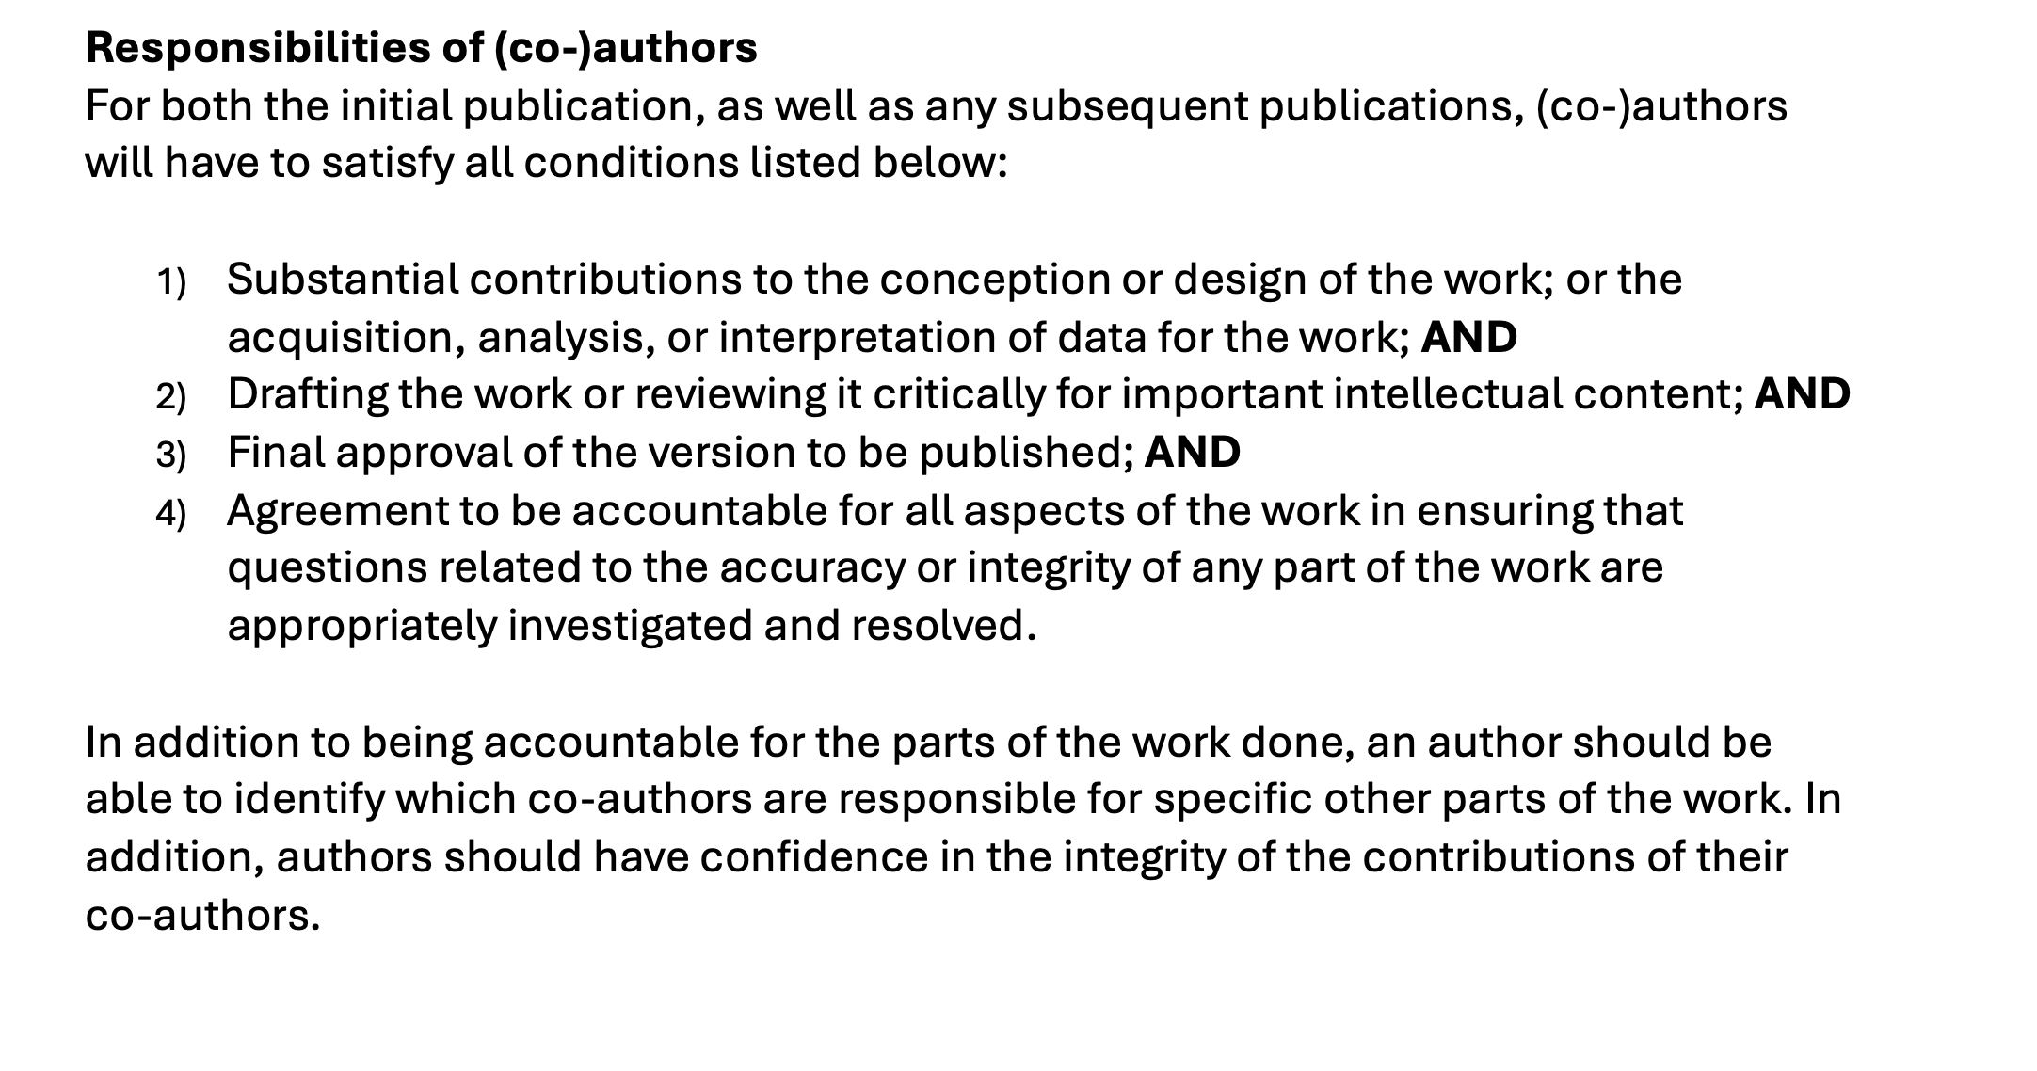

Slide 7
