Slide 1
ACROSS 4th Meeting
28 Sept 2026

Slide 2
Agenda
Introduction
Progress updates: IRB/Translation/Data collection
Timeline update
Author/Data policy reminder
AOB

Slide 3
Study progress
12 countries/regions 16 centres

Slide 4
Study progress
12 countries/regions 16 centres

Slide 5
Agenda
Introduction
Progress updates: IRB/Translation/Data collection
Timeline update
Author/Data policy reminder
AOB

Slide 6
Timeline
 | Original timeline | Revised timeline
Final survey shared | 6 Oct 2025 | Done
Translation/IRB application | Oct-Dec 2025 | Mar 2026 (submitted)
Data collection | Jan –June 2026 | Upon IRB approval - Oct 2026
We propose to extend data collection to 31 December 2026

Slide 7
Agenda
Introduction
Progress updates: IRB/Translation/Data collection
Timeline update
Data policy reminder
AOB

Slide 8
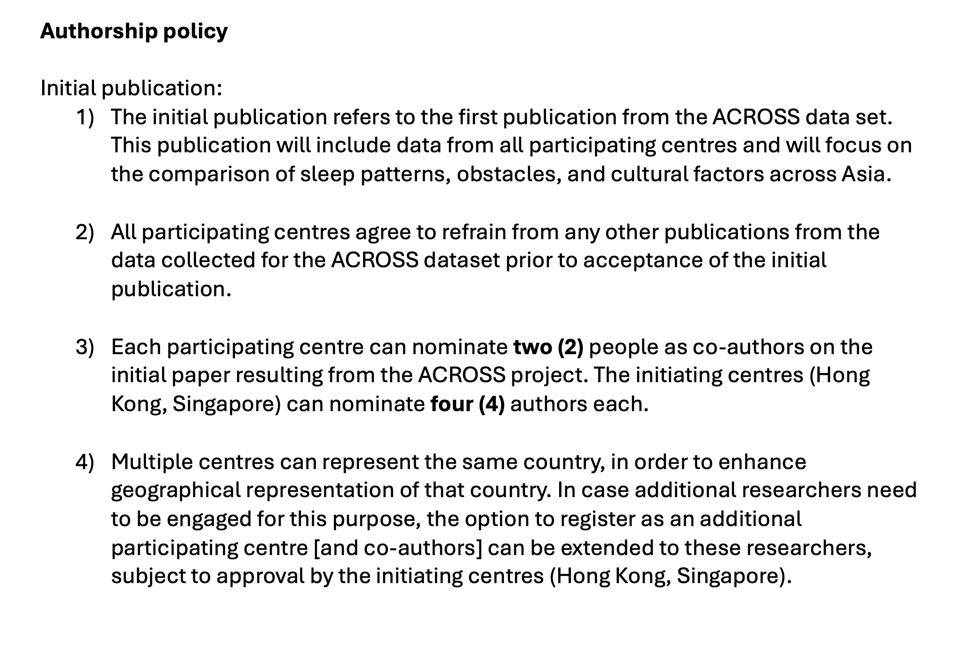
5) Author number will be capped at six (6) per country/region

Slide 9
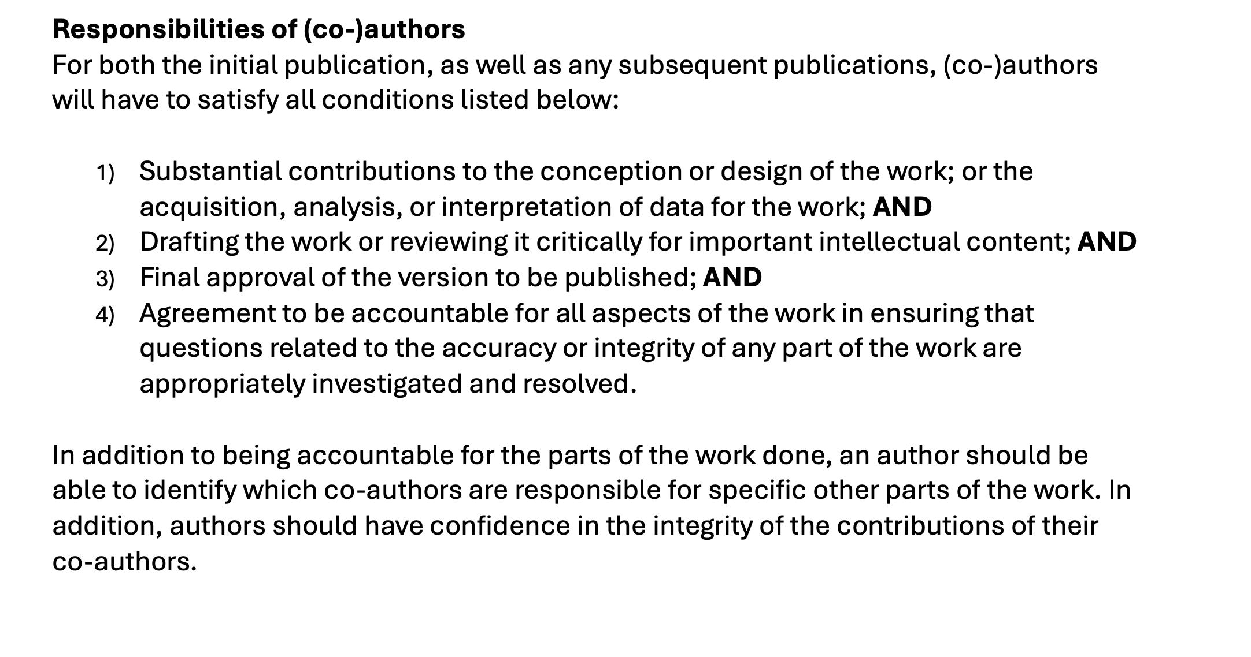

Slide 10
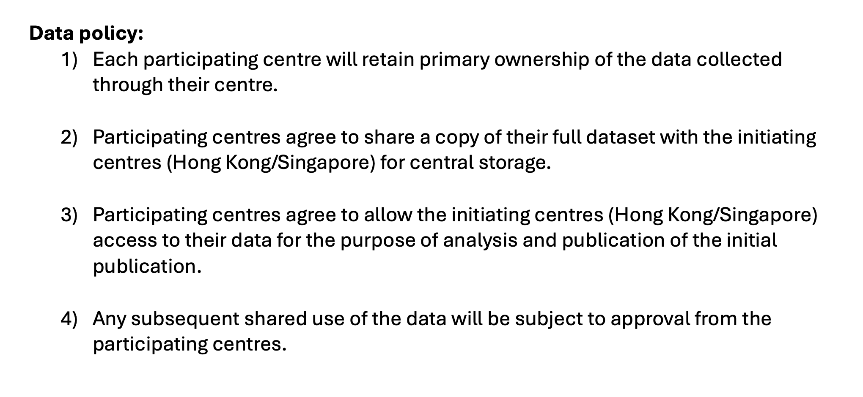
5) Subsequent publications based on each centre’s own data are allowed, after seeking/prioritizing joint publications.

Slide 11
Agenda
Introduction
Progress updates: IRB/Translation/Data collection
Timeline update
Author/Data policy reminder
AOB

