Slide 1
ACROSS Study
Survey Platform

Slide 2
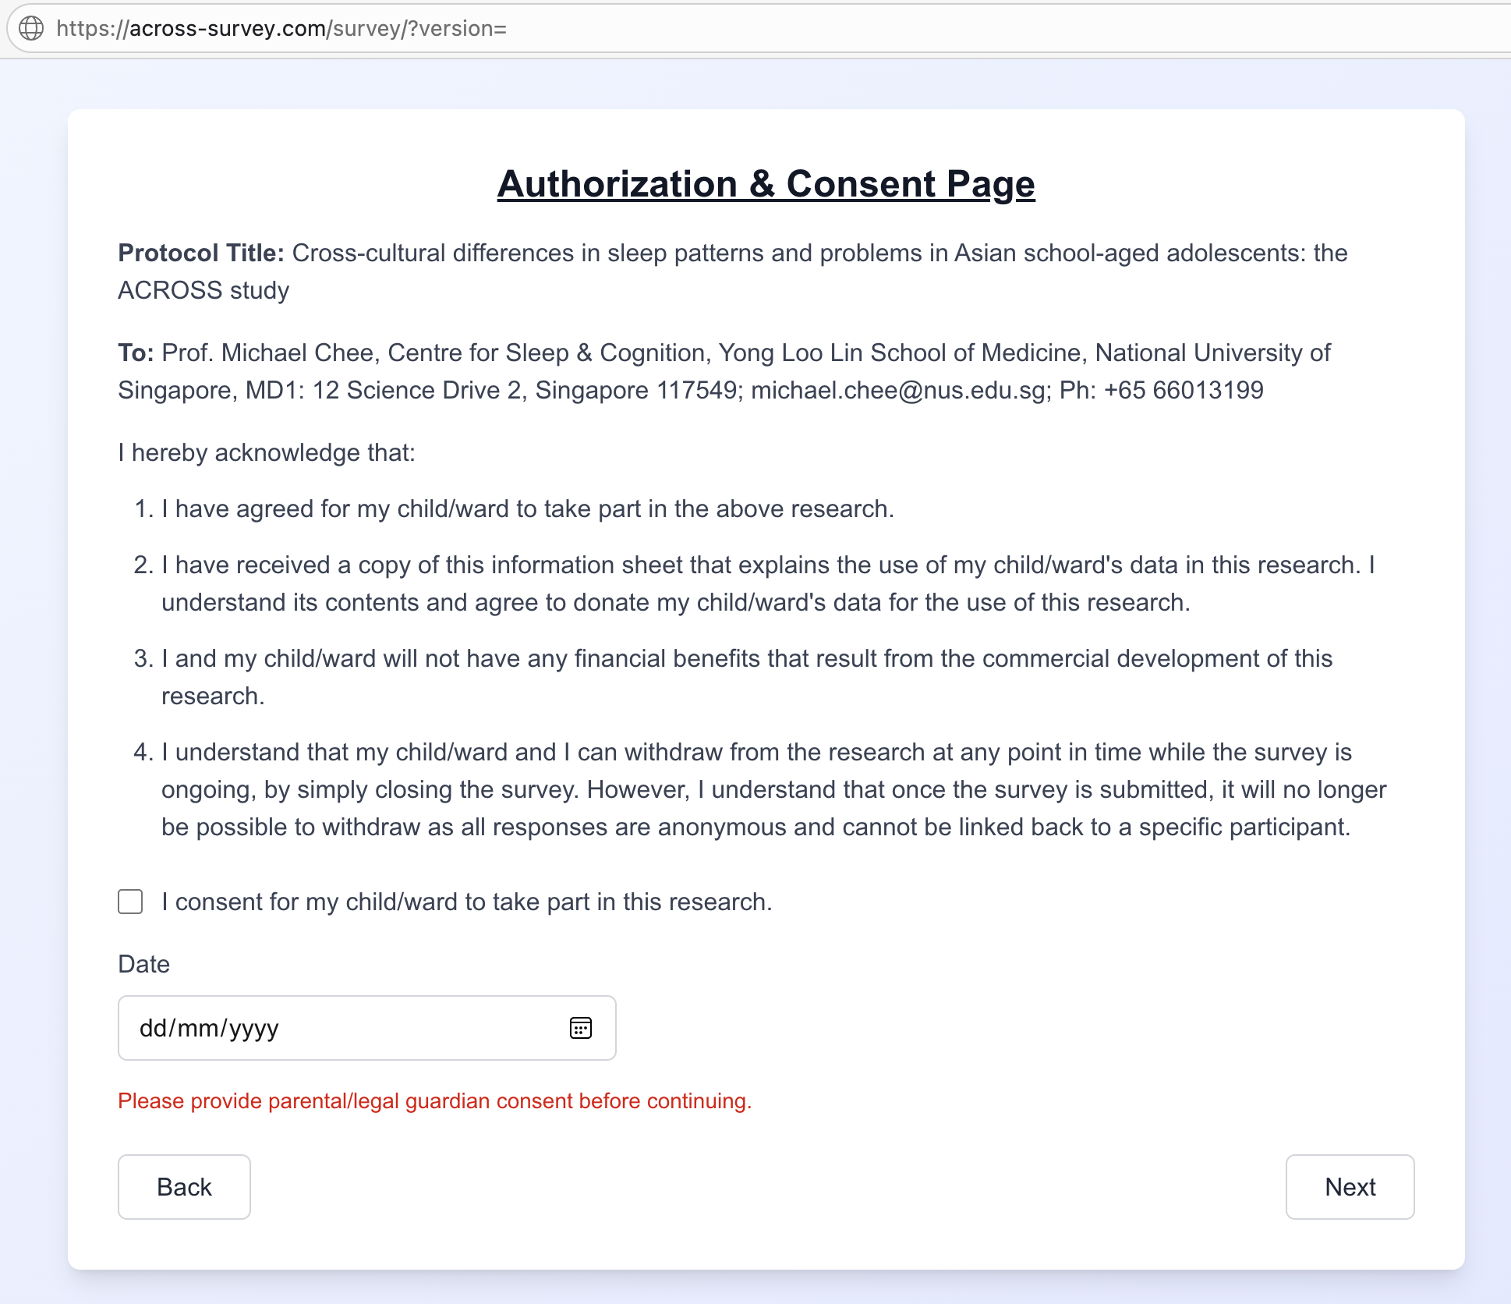
Questionnaire website
Each participating centre will have its unique survey link.
The landing page is the consent. Participants and their parent/guardian will have to check before proceeding to the questionnaire.

Slide 3
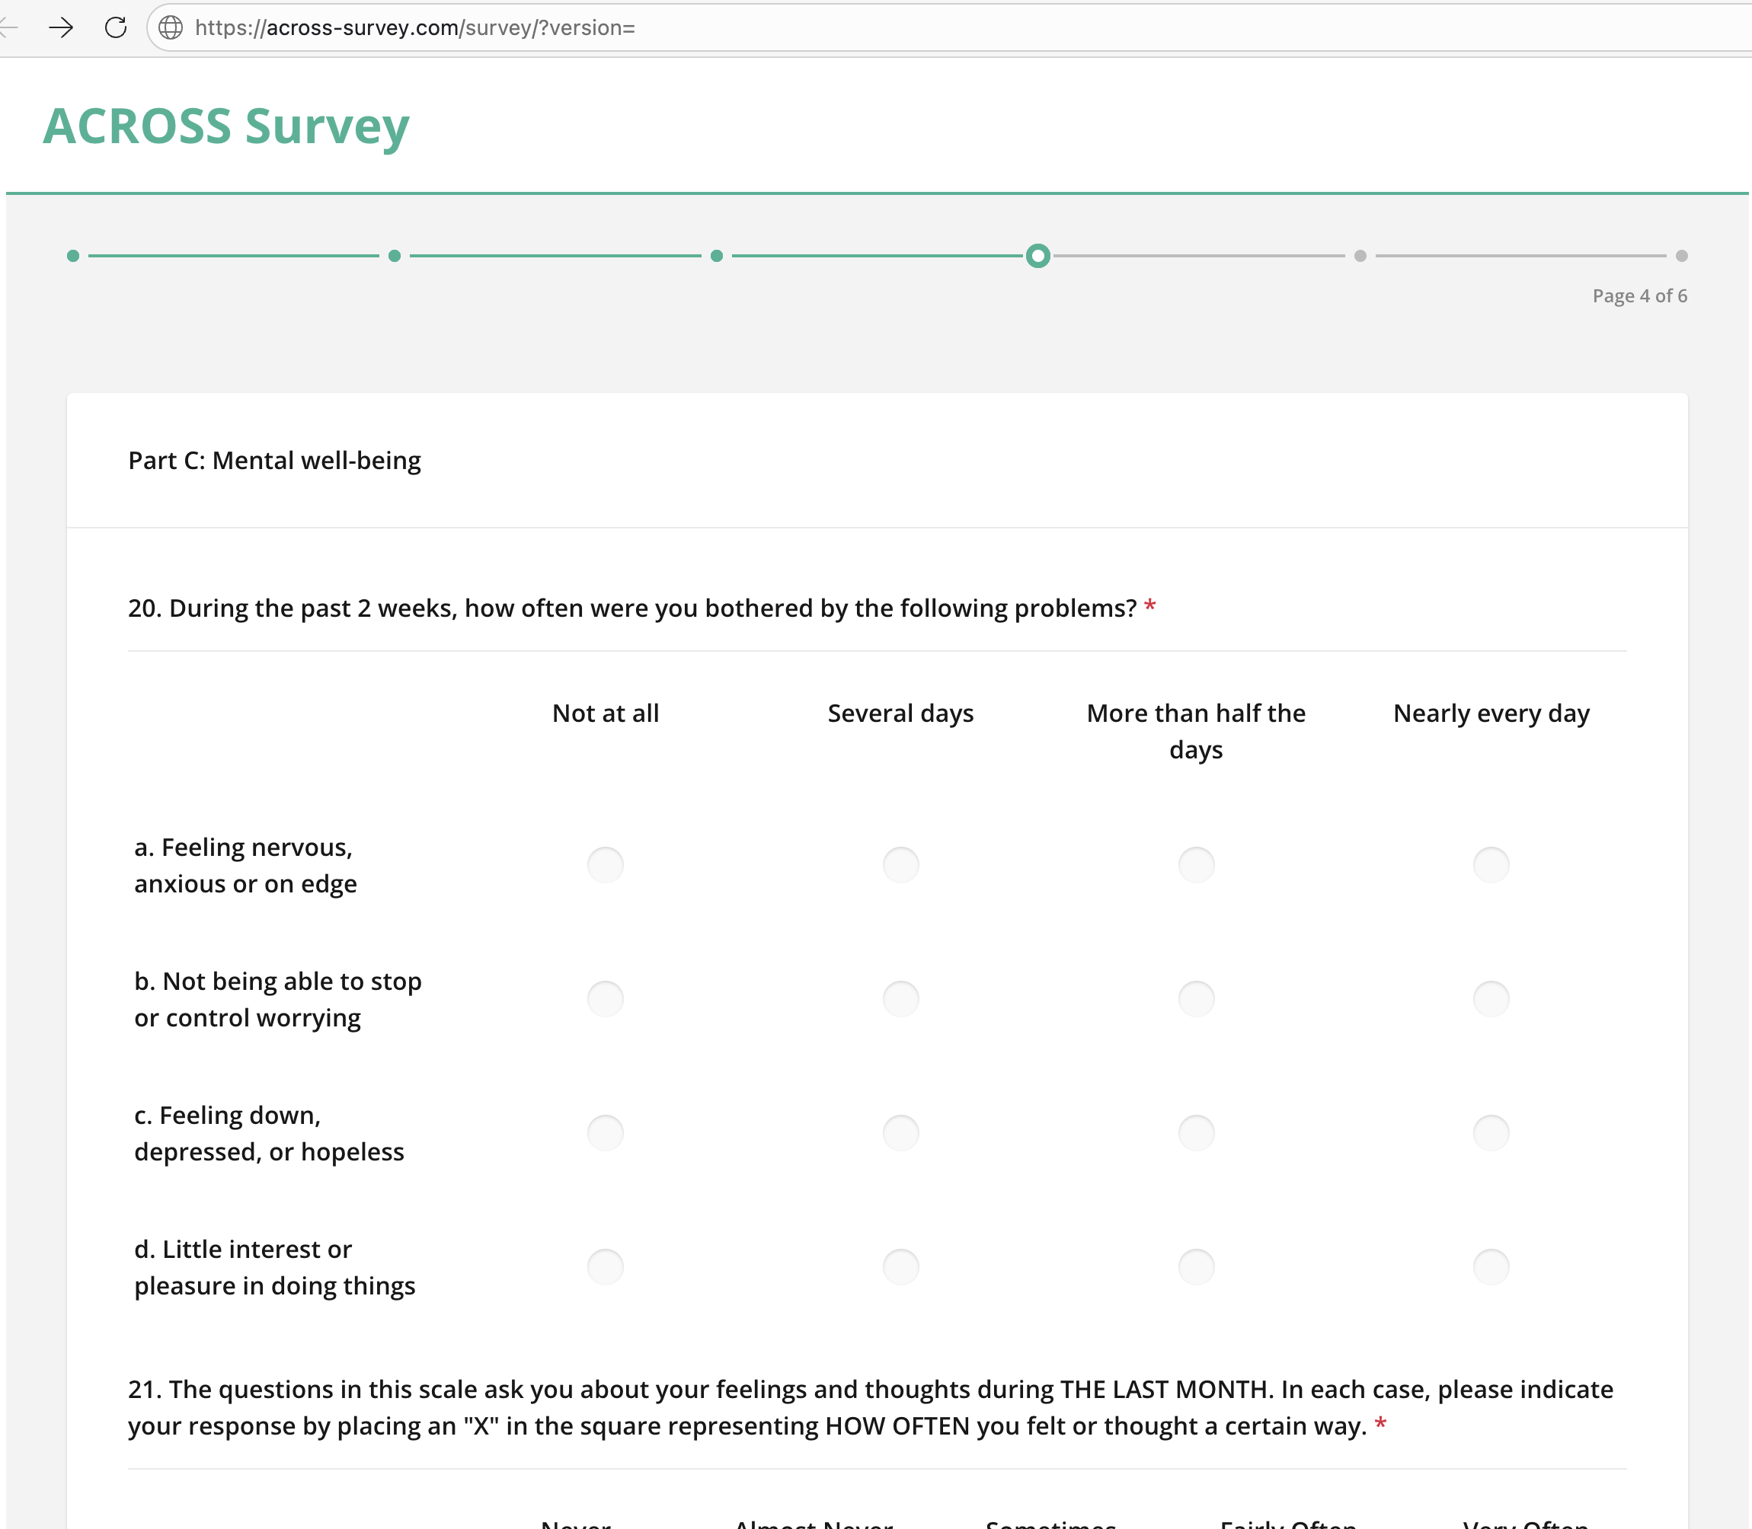
Questionnaire website
Each part of the questionnaire will be in separate pages.
Participants must fill in all the required questions before proceeding to next page.

Slide 4
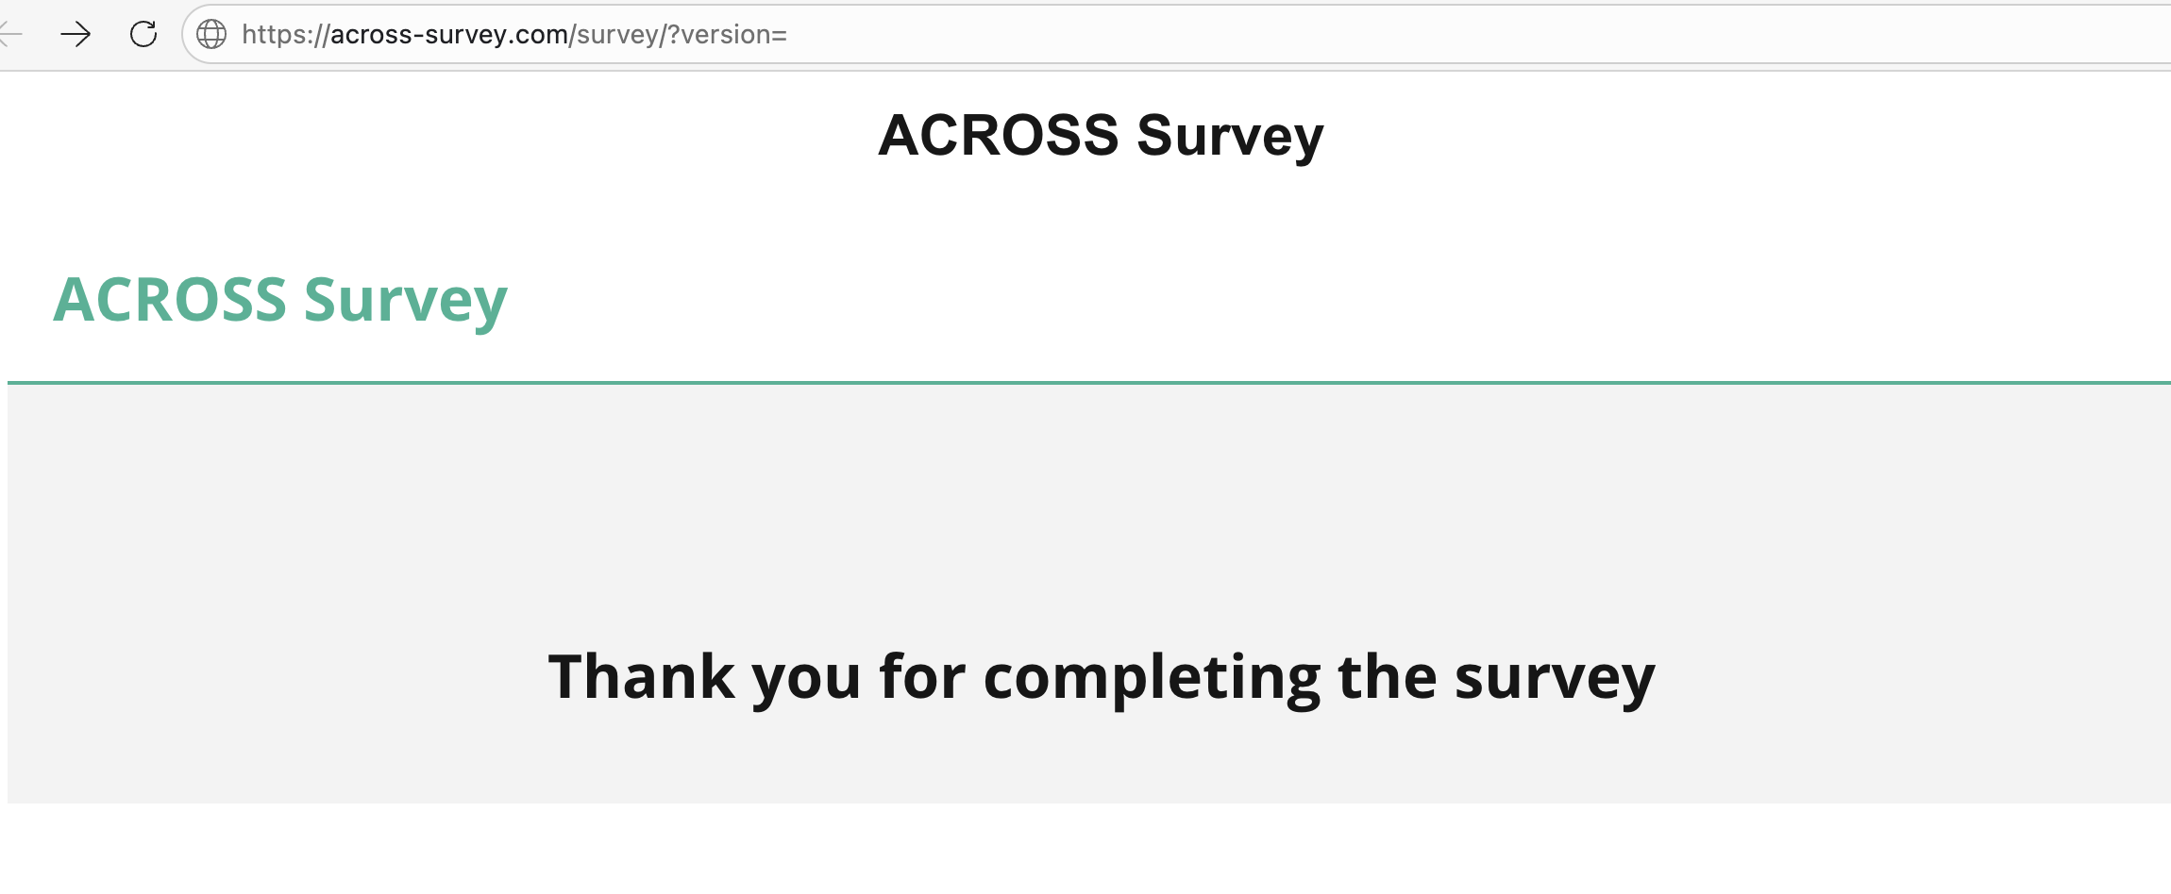
Questionnaire website
Participants can submit after they have completed all parts.

Slide 5
Survey uploading
When local survey translation is finalized → share with initiating centres
Technical team (Hong Kong) will upload translation and share survey link for testing
Review and correct before going live

Slide 6
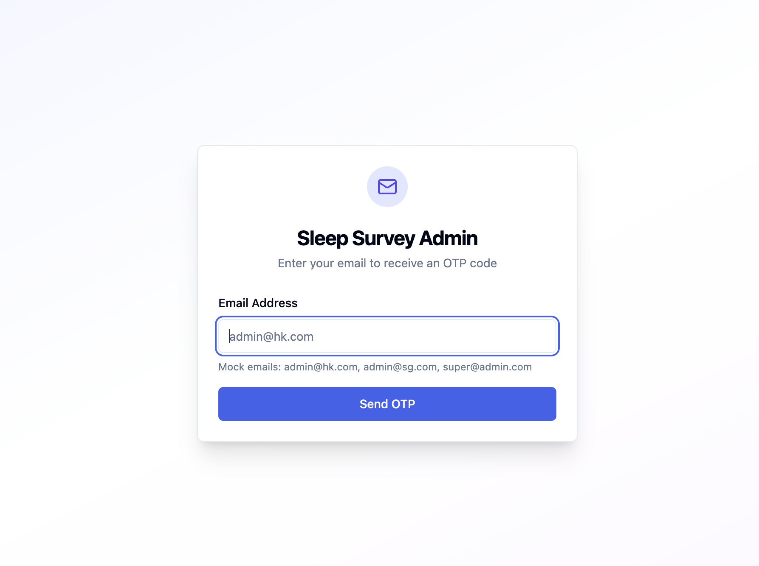
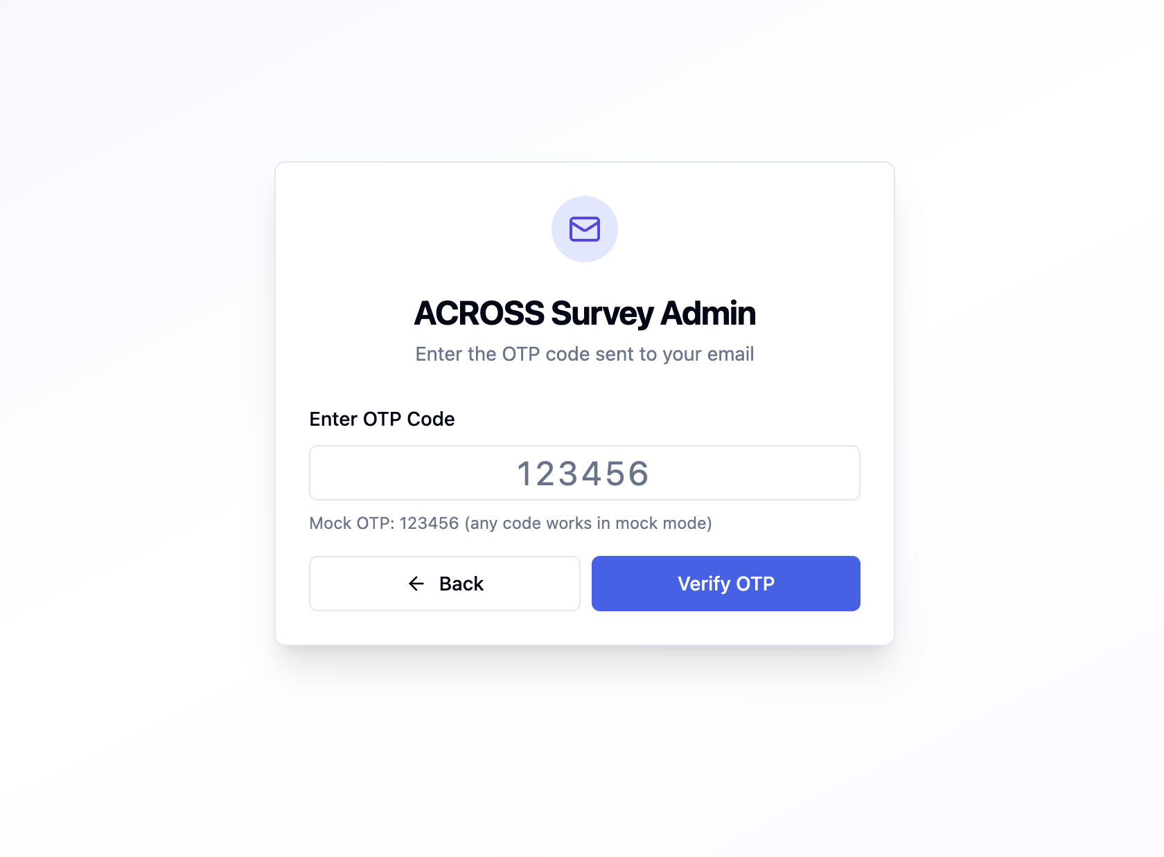
Admin Portal
Participating centre’s admin researchers can login with their email address.
A one-time passcode will be sent to their email address.

Slide 7
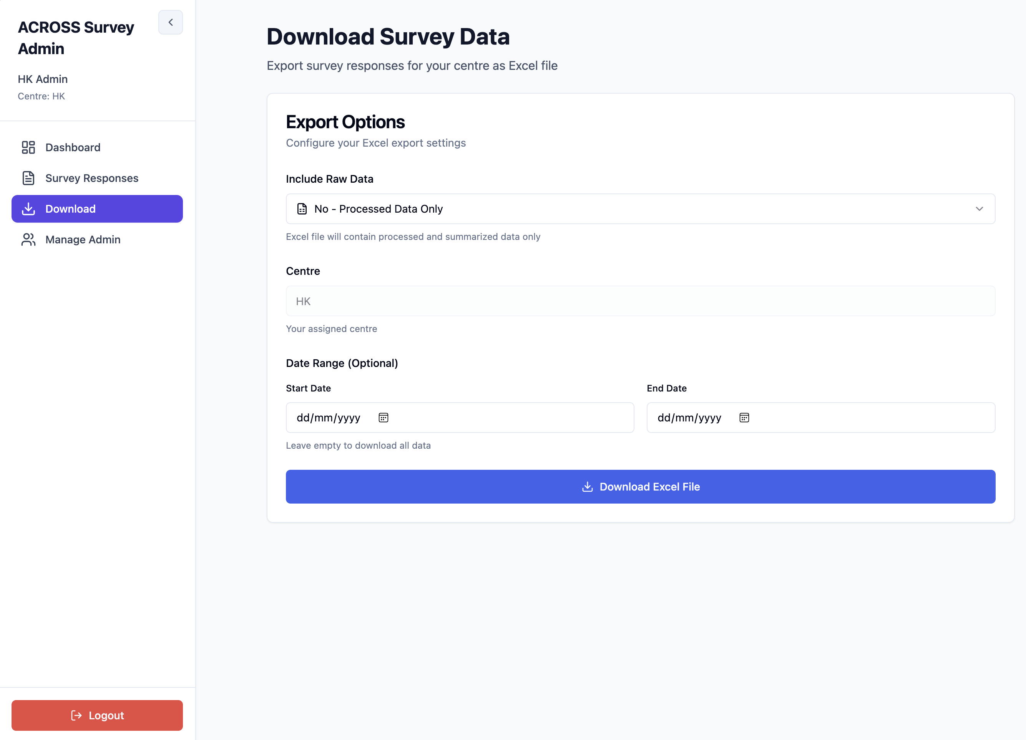
Admin Portal
Researchers can view and download the results submitted from their centre’s questionnaire link.

Slide 8
Data management
The platform (questionnaire, admin portal, database) will be hosted on AWS servers.
For ease of configuration and connectivity, the platform and database are hosted at AWS Hong Kong region.
Automated routine backup for database.
Admin portal access control, researchers can login with their registered emails and view/download results submitted from their questionnaire link.
Questionnaire/admin portal connection with HTTPS; database encryption for data both at rest and in transit.

